Slide 1
Memory and Attention

Slide 2


Slide 3
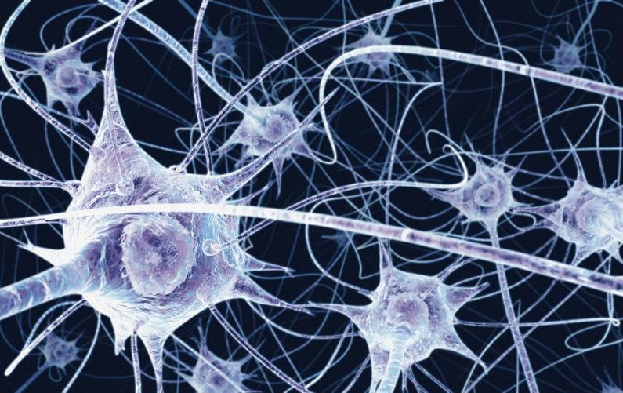

Slide 4
Overview
Memory and attention are key abilities of people
They enable us to act in the world.
Very important for interactive systems designers
We look at
Major components of memory and attention

Slide 5
Memory 1
without the capacity to remember and to learn, it is difficult to imagine what life would be like, whether it could be called living at all. Without memory, we would be servants of the moment, with nothing but our innate reflexes to help us deal with the world. There could be no language, no art, no science, no culture.’ (Blakemore, 1988)

Slide 6
Memory 2
Memory is not simple information store but has a complex structure.
Common concept: short-term– long-term memory
Latest research says memory has the following components
Sensory Stores
Working Memory
Long Term Memory

Slide 7
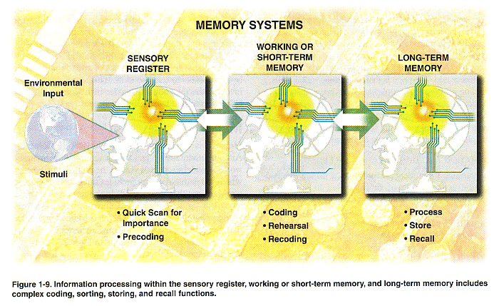

Slide 8

in the brain
buffers for stimuli received through senses
iconic memory: visual stimuli
Fireworks leave a peristent image
Remains in the order of 0.5 seconds
echoic memory: aural stimuli ... what did you say?
haptic memory: tactile stimuli
continuously overwritten
Notes:
We can demonstrate the existence of iconic memory by moving a finger in front
of the eye. Can you see it in more than one place at once? This indicates a persistence
of the image after the stimulus has been removed
A similar effect is noticed most
vividly at firework displays where moving sparklers leave a persistent image.
Sometimes when we are reading and someone asks us a question we ask them to repeat only to realize we have heard it the first time

Slide 9
Sensory Memory to Short Term Memory
Information is passed from sensory memory into short-term memory by attention
We can choose to focus on one stimuli
Having a conversation in a crowded room

Slide 10
short-term memory (STM)
also called ‘working memory’
scratch-pad for temporary recall
rapid access ~ 70ms
limited time ~ 30s without rehearsal
limited capacity – 7± 2 chunk

Slide 11
Working Memory
Working memory has limited space
Things decay out of it
Items can also be displaced
In order to retain items we rehearse them..the inner voice

Slide 12
Working Memory
265397620853
Look at the number above
Now write down as much of the number as you can remember
If you can remember between 5 to 9 digits your memory is average
Now look at the following number
0092 51 2289920
Can you remember more? Why
Chunking can increase the information you can remember
Also meaning increases memory

Slide 13
Chunking
The general rule is that humans can remember 7 ± 2 chunks of information at a time
The successful formation of a chunk is known as closure.
This process can be generalized to account for the desire to complete
or close tasks held in short-term memory.

Slide 14
Chunking
Why are the numbers on the mobile scratch cards divided into groups of 4?
Old ATM designs return cash first . What was the problem?
Notes:
When we enter 4 digits we reach closure and we move on to the next chunk this makes it easier to remember.

Slide 15
Working Memory
3 components :
central executive,
visuo-spatial sketchpad
articulatory loop

Slide 16
Central Executive
The central executive is involved in decision making, planning and related activities.
It is also closely linked to managing our ability to perform more than one thing at a time

Slide 17
Articulatory Loop
behaves like a loop of audio tape.
Dialing an unfamiliar telephone number or repeating a phrase in a foreign language
Aloud or to ourselves
This process is called rehearsal.
the inner voice.
The analogy of the audio tape because the loop is limited in both capacity and duration.

Slide 18
The visuo-spatial sketchpad
Mind’s eye.
This is believed to hold visual information
Visualize a route through a town or the mental rotation of a coin
Limited in capacity and duration unless refreshed by means of rehearsal.
A chunk can phrase or an image.

Slide 19
Forgetting from working memory
Decay : Memory simply fades with time, a point e.g in working memory information decays in about 30 seconds without rehearsal.
Displacement: Memory replaced with new item due to limited storage capacity of working memory

Slide 20
Implications of Short Term Memory
Modes in Software:
Modes can be useful as they allow us to have more options without increasing the number of buttons
They can also cause mode errors
Users forget which mode they are in
Example of modes
Digital camera same button to take picture and record video
In a drawing program, clicking and dragging normally selects one or more graphic objects on the drawing, but when the software is in “draw rectangle” mode, clicking and dragging adds a rectangle to the drawing and stretches it to the desired size.

Slide 21
Implications of Short Term Memory
Solution for Mode Errors???
Avoid modes
If that is not possible give strong feedback about which mode the software is in.

Slide 22
Implications of Short Term Memory
Instructions
We tend to forget long instructions and often have to refer back to them
Think about asking for directions
Solution is to make instructions visible

Slide 23
long-term memory
repository for all our knowledge ... and who we are
slow access – relative to STM
slowly created – rehearsal
slow decay, if any
huge or unlimited capacity

Slide 24
Types of Long-term memory
Long-term memory is usually divided into two types
Explicit memories (Declarative Memories)
include all of the memories that are available in consciousness.
Explicit memory can be further divided into episodic memory (specific events) and semantic memory (knowledge about the world).
Implicit memories (Non-Declarative Memories)
Implicit memories are those that are mostly unconscious.
This type of memory includes procedural memory, which involves memories of body movement and how to use objects in the environment.

Slide 25
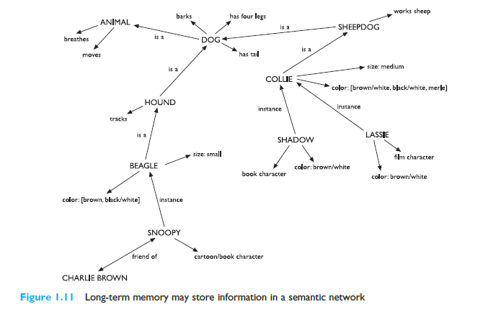

Slide 26
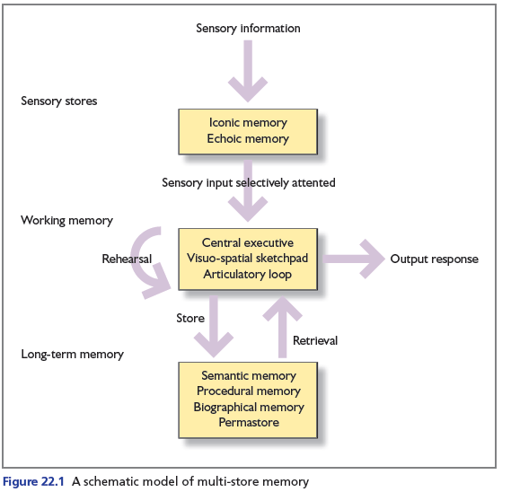

Slide 27
How do we remember?
To remove this ambiguity
store and encode will mean placing in memory
retrieve and recall to mean bring back from memory.
If the information does not exceed the capacity of working memory, we will rehearse it, i.e use the inner voice
Useful for remembering unfamiliar names or numbers
Exploits the articulatory loop of working memory.

Slide 28
Retrieving memories
We are able to retrieve stored information by way of recall and/or recognition.
Recall: Individuals actively search their memories to retrieve a particular piece of information.
Recognition: Automatic searching of our memory to check if a piece of stimuli matches some content in our memory stores.
This gives rise to one of the important design theories derived from understanding memory – design for recognition rather than recall.

Slide 29
Recognition vs recall
What is the capital of Sweden

Slide 30
Forgetting; one theory
Interference theory takes two forms:
retroactive interference (RI) and
proactive interference (PI).

Slide 31
Retroactive interference
Retroactive interference
newer learning interferes with earlier learning.
E.g. having been used to driving a manual-shift car, spending time on holiday driving an automatic may interfere with the way one drives after returning home.

Slide 32
Proactive interference
Proactive interference –
earlier learning interferes with new learning.
However, despite these and numerous other examples of PI and RI, there is surprisingly little outside the laboratory to support this theory.

Slide 33
Design Implications of Long Term Memory Characters
Do not burden users memory.
Provide memory aids

Slide 34
Reading
Read Chapter 22 of text book up to page number 540
Designing interactive System

